Slide 1
PCORnet Common Data Model
v.1 9/25/2019

Slide 2
Objectives
Define what the PCORnet Common Data Model (CDM) is
Describe how the PCORnet CDM can help researchers
Provide detail on data contained in the CDM
Explain how the PCORnet CDM is created, supported, and used
Describe challenges and limitations of the CDM

Slide 3
Here we have a diabetes research team who wants work on a project together. Their project requires analyzing data from electronic health records.
Notes:
Here we have a research team who wants work on a project together. Their project requires analyzing data from electronic health records.
They all are diabetes researchers and have a good working relationship, there’s just one problem: they work for different universities throughout the country.

Slide 4
Here we have a research team who wants work on a project together. Their project requires analyzing data from electronic health records.
They all are diabetes researchers and have a good working relationship, there’s just one problem: they work for different universities throughout the country.

Slide 5
?
?
Date: 8/16/2018
MRN: 555777111
Diagnosis: E10.2
A1C: 8.5%
Medications: Metformin
Date: 9/26/2016
MRN: 888999222
Diagnosis: E10
A1C: 10.5%
Medications: Metformin
Date:3/1/2017
MRN: 444222000
Diagnosis: E10.5
A1C: 7.5%
Medications: Insulin
Notes:
Each member of the research team meets with the team who manages requests for clinical data at their institution. Because all of their health systems uses, the same electronic health record, they expect that it will be pretty easy to find and, eventually, analyze the data.

Slide 6
Each member of the research team meets with the team who manages requests for clinical data at their institution. Because all of their health systems uses, the same electronic health record, they expect that it will be pretty easy to find and, eventually, analyze the data.

Slide 7
$$$
Date: 8/16/2018
MRN: 555777111
Diagnosis: E10.2
A1C: 8.5%
Medications: Metformin
Date: 9/26/2016
MRN: 888999222
Diagnosis: E10
A1C: 10.5%
Medications: Metformin
Date:3/1/2017
MRN: 444222000
Diagnosis: E10.5
A1C: 7.5%
Medications: Insulin
Notes:
To their surprise, there are major variations in the data at each site and the costs to extract all the data is expensive. They are worried they won’t have enough funds to cover the data extraction at each suite. They are also worried about how they will handle the analysis when they receive three very different datasets from the sites. They’ll have to dedicate more funds to preparing the data for analysis.

Slide 8
To their surprise, there are major variations in the data at each site and the costs to extract all the data is expensive. They are worried they won’t have enough funds to cover the data extraction at each suite. They are also worried about how they will handle the analysis when they receive three very different datasets from the sites. They’ll have to dedicate more funds to preparing the data for analysis.

Slide 9
How can the PCORnet CDM help this stressed out research team?

Slide 10
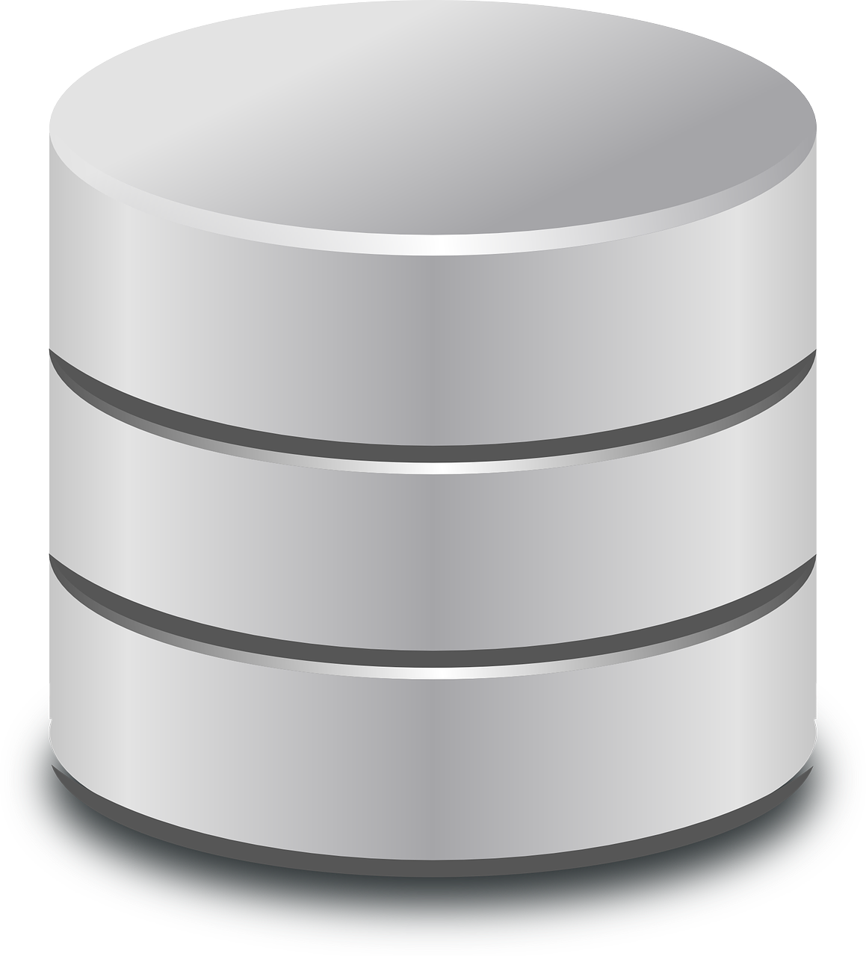
First, a bit of background…
PCORnet does not (and should not) have access to all of the data from your health system. Each PCORnet site needs to store a subset of the health system’s data in a separate database, sometimes referred to as a data mart.
This data mart needs to follow PCORnet’s specifications, which are known as the PCORnet Common Data Model.
Notes:
Your care provider enters data about you and your visit into the electronic health record. These data are stored in a large database within the health system.

Slide 11
First, a bit of background…
Your care provider enters data about you and your visit into the electronic health record.
These data are stored in a large database within the health system.
PCORnet does not (and should not) have access to all of the data from your health system. So each PCORnet site needs to store a subset of the health system’s data in a separate database, sometimes referred to as a data mart.
This data mart needs to follow PCORnet’s specifications, which are known as the PCORnet Common Data Model.

Slide 12
The PCORnet Common Data Model
The PCORnet Common Data Model is a specification that defines how data is stored, structured, and labeled for all PCORnet sites.
All PCORnet sites use the PCORnet CDM to store clinical data for the network.
Acronyms:
PCORnet CDM
PCDM

Slide 13
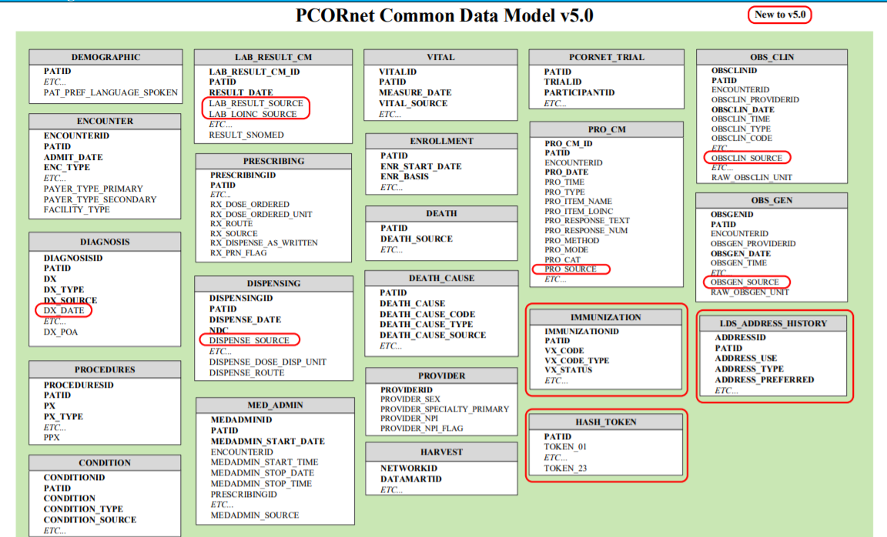
PCORnet Common Data Model v5.0
Notes:
Each box represents a “table” in the database and each item within a box represents a column in that table. So, for example, the Procedures table includes a ID for the procedure, the ID for the patient who had the procedure, and a code representing the procedure.

Slide 14
The PCDM allow data across sites to be compared.
UNC’s data is optimized and coded for our organization. But what if we want to share it?
If we just try to smash our data with, say, all of Duke’s data, we’ll be...

Slide 15
The PCDM allow data across sites to be compared.
But if we all create a database (data mart) and use the same agreed structure
…we’ll have an instance of our data that’s sharable in a number of ways.
(close enough)

Slide 16
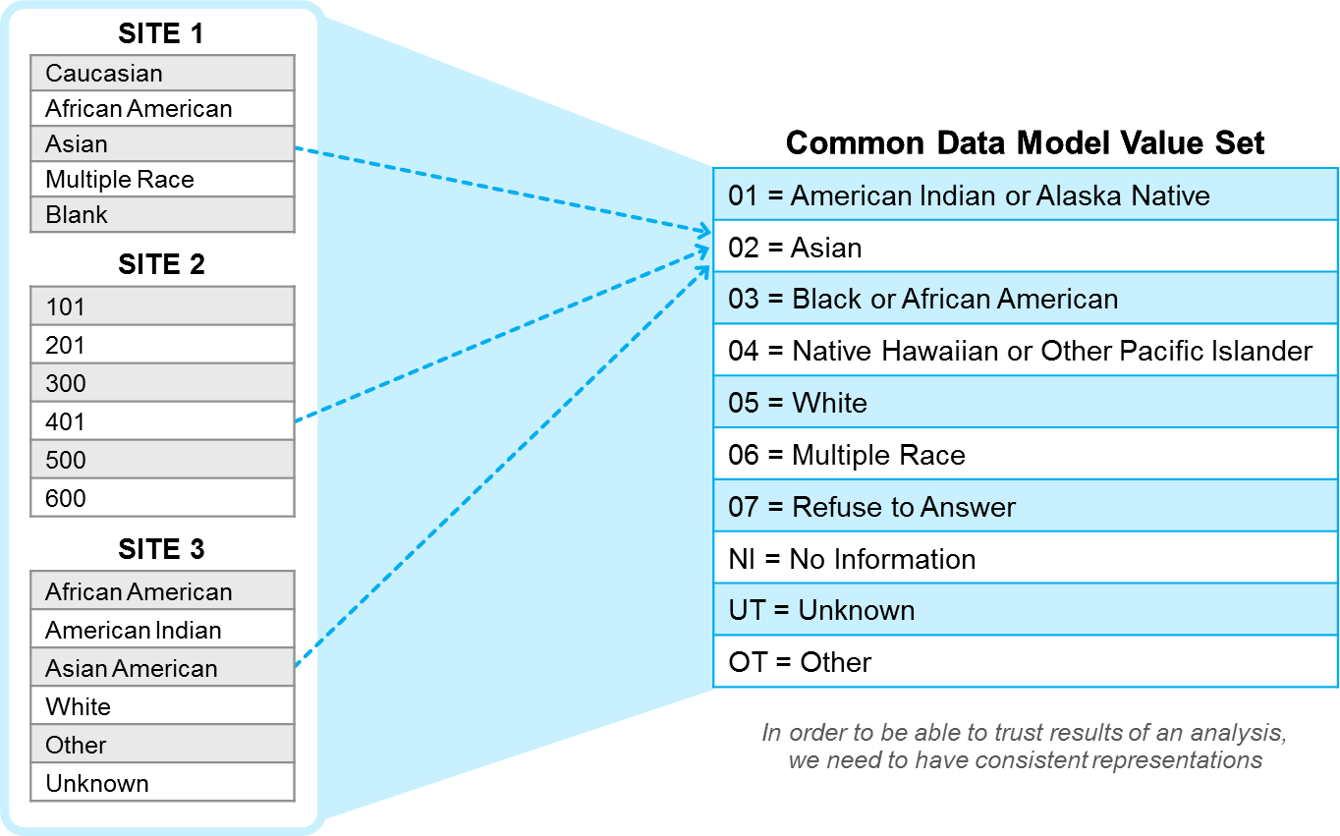
The PCDM allow data across sites to be compared.
Notes:
Same data are represented differently at different institutions (e.g., Race)
For example, the left side of this slide illustrates how data from three different sites might be represented
Three different ways to represent the same event
On the right, you can see how the Common Data Model standardizes these into a single language

Slide 17
Data Categories
Demographics
Encounter (i.e., Visit Information)
Diagnoses
Procedures
Conditions
Labs
Medications
Vitals
Death and Death Cause
Provider
Patient Reported Outcomes
Immunization
Address History (no data smaller than zip code)

Slide 18
Coding Systems
Medical record systems (and the PCORnet CDM) leverage coding systems to organize data.
For example, diagnoses are recorded using the International Classification of Diseases version 10 (ICD-10) system.
Type 1 diabetes = E10
Type 1 diabetes with kidney complications = E10.2
Without these common coding systems, it would be very difficult to query the data.

Slide 19
Coding Systems
Some coding systems are used more consistently than others.
ICD (for diagnoses and procedures) and CPT (for procedures)
Used for billing
Completed consistently (for the most part)
May see variability between providers and health systems in how an individual diagnosis is coded
LOINC (for labs) and RxNorm (for meds)
Much more variable in how they are used
More challenging for researchers and analysts to select the right codes on which to query

Slide 20
Creating the PCORnet CDM
The PCORnet Coordinating Center leads the creation of the PCORnet CDM, with some input from the sites.
Considerations when creating the CDM:
What will be valuable for researchers?
What data elements could be formatted meaningfully across sites?
The PCORnet CDM is updated periodically. Version 5.0 is launching this month.

Slide 21
Specification
PCORnet produces very specific instructions (200+ pages) for sites to use in this process. For example:

Slide 22
Every quarter, sites must complete a data refresh and curation
Data refresh – Add in new data (new patients, new events) from the previous quarter
Data curation
Run a program from PCORnet that explores data quality and conformance
Each site must past several data checks.
If a site does not pass a data check, they must fix the issue or provide an explanation.
Example data checks:
More than 5% of records have future dates
The average number of principal diagnoses per encounter is above threshold (2.0)
Notes:
In the data refresh step, we add in new data (new patients, new events) from the previous quarter.
In the data curation step, we run a program from PCORnet that explores quality and conformance of our data.
Each site must past several data checks
If a site does not pass a data check, they must fix the issue or provide an explanation.
Example data checks:
More than 5% of records have future dates
The average number of principal diagnoses per encounter is above threshold (2.0)

Slide 23
Every quarter, sites must complete a data refresh and curation
In the data refresh step, we add in new data (new patients, new events) from the previous quarter.
In the data curation step, we run a program from PCORnet that explores quality and conformance of our data.
Each site must past several data checks
If a site does not pass a data check, they must fix the issue or provide an explanation.
Example data checks:
More than 5% of records have future dates
The average number of principal diagnoses per encounter is above threshold (2.0)

Slide 24
Distributed Queries
One of the greatest benefits of the PCDM is the ability to support distributed queries.
Distributed query
Written by one site and then sent to other sites
Other sites run the same query on their data, without modification
This is valuable for researchers:
Reduces costs
Data received are similarly formatted and structured

Slide 25
Distributed Queries
One of the greatest benefits of the PCDM is the ability to support distributed queries.
A distributed query is written by one site and then sent to other sites, who can run the same query on their data, without modification.
This is valuable for researchers:
It reduces the costs of running the query across sites.
Data received are formatted and structured in the same manner, making it easier to analyze data without extensive “data cleaning.”

Slide 26
When the PCORnet CDM is not so common…
Sites need to balance the need for a common data structure with the realities of personnel capacity and limitations of their data.
Many STAR sites are not able to support every variable in the CDM.
Example: UNC does not support “days supply” in prescribing
It is important for us to discuss data needs with researchers to ensure we have the data they need.

Slide 27
When the PCORnet CDM is not so common…
When sites implement the PCDM, they need to balance the need for a common data structure with the realities of personnel capacity and limitations of their data.
Many STAR sites are not able to support every variable in the CDM. UNC, for example, does not currently have data available in the “days supply” field in prescribing.
This means that it is important for our researchers to have a conversation with us about their data needs so we can be sure we have the data required for their project.

Slide 28
What’s a sidecar?
Sidecar – data needed for a project that is not available in the PCDM
A distributed query cannot be written for a sidecar.
PCDM only covers a portion of the data from the medical record; researchers may need additional data
For example: maternity data, notes, identifiers
Use of side cars should be limited and the costs/benefits should be carefully weighed.

Slide 29
What’s a sidecar?
A sidecar is what we call data needed for a project that is not available in the PCORnet CDM.
A side car necessitates that each site write a query to pull the data at their site. A distributed query cannot be written for a sidecar.
The PCORnet CDM only covers a portion of the data represented in a patient’s medical record and there are times when researchers need additional data.
For example: maternity data, notes, identifiers
Use of side cars should be limited and the costs/benefits should be carefully weighed.

Slide 30
Summary: PCORnet CDM
Benefits
Limitations
Allows for distributed queries, reducing costs
Allows for analysis of relatively consistent datasets across sites
Covers a broad range of commonly used data categories
Well documented
Requires substantial staff time to maintain high quality and current data
Does not contain all data elements a researcher may need
Some variability across sites remains

Slide 31
☺

Slide 32
After learning about what the PCORnet CDM can offer them, this multi-site study team decides they can obtain all the data the need from the CDM for their analysis. Next, they’ll meet with an analyst at their lead site to discuss next steps for developing a distributed query.

Slide 33
Questions?

